Slide 1
CUI
Submitting and Tracking MWR IT HELPDESK
How-To Guide
Controlled by: HQ IMCOM Controlled by: AMIM-G3
CUI Category: OPSEC
Limited Dissemination Control: DL ONLY POC: John.Doe.civ@army.mil/210.466.0014
As of: 30AUG2023

Slide 2
Submitting MWR IT HELPDESK
How-To Guide
CUI
This How-to-Guide will help USAG Humphreys employees request services from the USAG Humphreys, MWR GISO team. This can include:
  Issues with systems
  Networks
  Printers
  Any other IT related issues or requests.
SharePoint Help Desk Ticket System enhanced capabilities
  Allows users live tracking on the progress of their requests
  Central point for communication among ISO staff and ticket requestors
USAG-Humphreys is activitely building SharePoint. Recommend to save the following links to your favorites.
  Humphreys MWR SharePoint (Main Page): Directorate of Family and Morale, Welfare & Recreation (sharepoint-mil.us)
  Humphreys MWR, ISO SharePoint (Main Page and Help Desk Location): USAG-H, FMWR, NAF Support Management (NSM), GISO (sharepoint-mil.us)
2
CUI

Slide 3
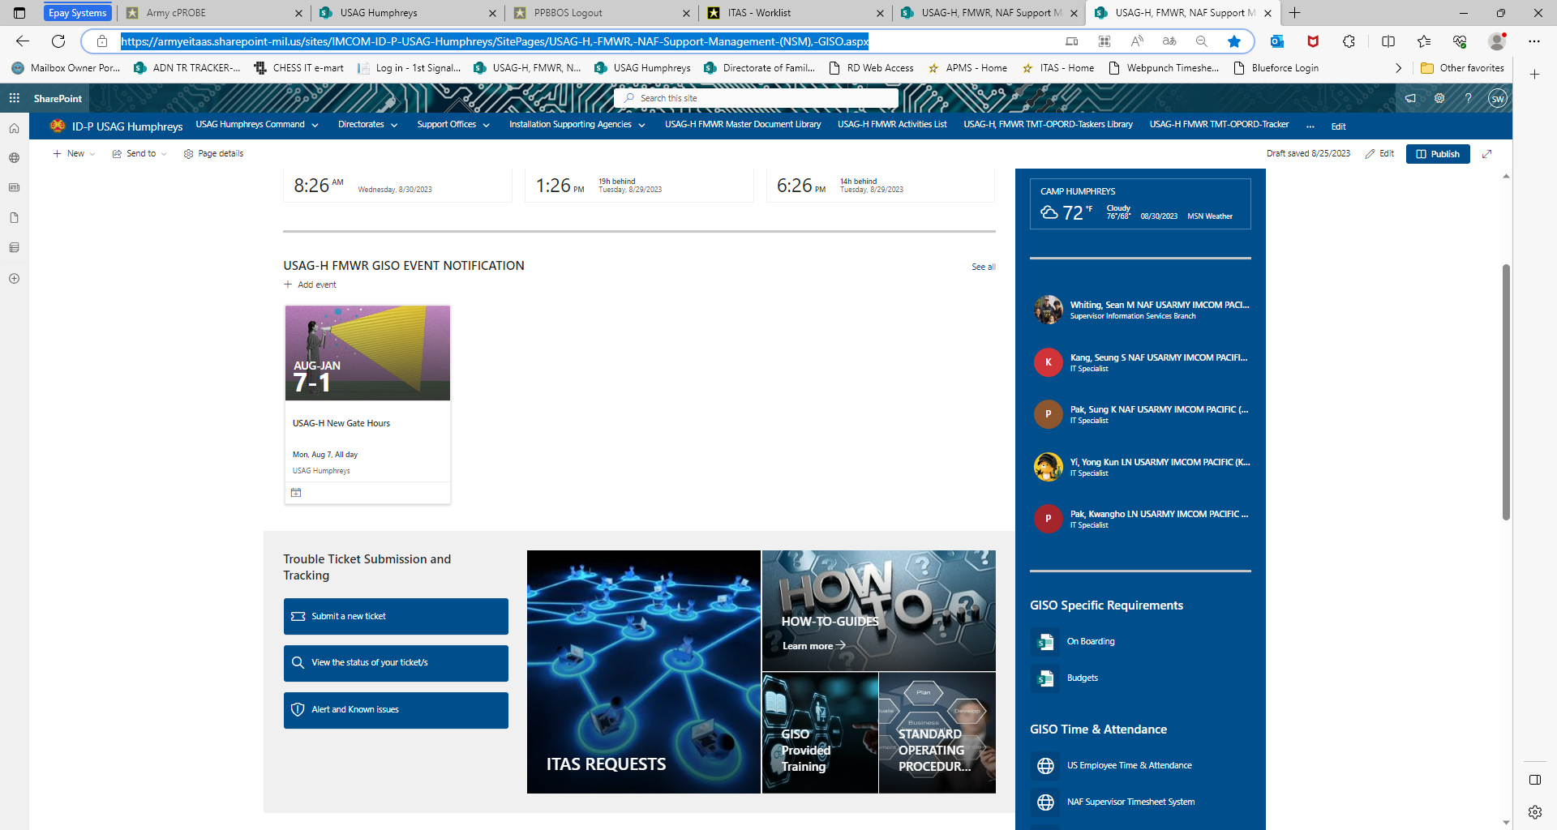
Submitting MWR IT HELPDESK
How-To Guide
CUI
Navigate to: USAG-H, FMWR, NAF Support Management (NSM), GISO (sharepoint-mil.us)
Click on “Submit a New Trouble Ticket
**It might ask you to sign in with your CAC credentials**
3
CUI
Notes:
Need TP for FIP

Slide 4
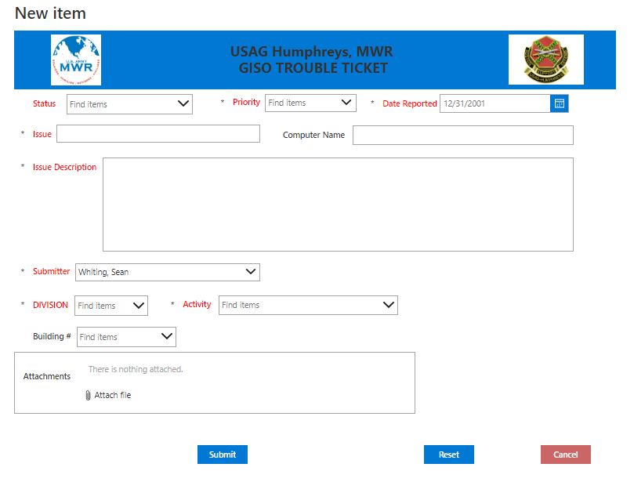
Submitting MWR IT HELPDESK
How-To Guide
CUI
Fill out this screen with
Status: NEW
Priority:
Critical = Full Work Stoppage with short suspense do, No Comms in Building, etc.
High = Work Stoppage and short suspense, etc.
Medium = Issue with major Application or Program, but work can still be completed, etc.
Low = Nice to have, Future Project, want the IT team to Look into creating designing, or implementing
Date Reported: Select the date you are submitting this request, Click “OK”
4
CUI

Slide 5
Submitting MWR IT HELPDESK
How-To Guide
CUI
Computer Name: HUMPXXXX if a computer is the issue
Issue Description:
Fill this out with as much detail as you can.!! This will help the technician understand this issue in more detail to help make resolving the issue more efficiently
5
CUI

Slide 6
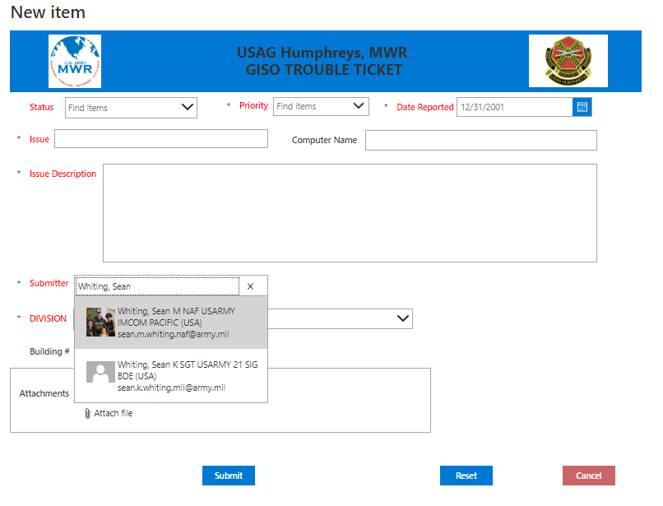
Submitting MWR IT HELPDESK
How-To Guide
CUI
Submitter:
Type Last Name, First Name
Select the name of the employee that is having the issue or request.
****If employee is in-processing anyone with access can submit request for that employee****
6
CUI

Slide 7
Submitting MWR IT HELPDESK
How-To Guide
CUI
Division: Select Division the Employee works under
Activity: Select Activity the Employee works for
Building: Select the building the Employee works in or the building the system or request is going to be needed
Attachments: Upload any attachment required (i.e. DD Form 2875, AUP, etc when in processing, or Screen shots of issue if possible)
7
CUI

Slide 8
Submitting MWR IT HELPDESK
How-To Guide
CUI
Click “Submit” when complete
If you want to reset the Form, Click ‘reset” this will set the form back to a new blank Form
8
CUI

Slide 9
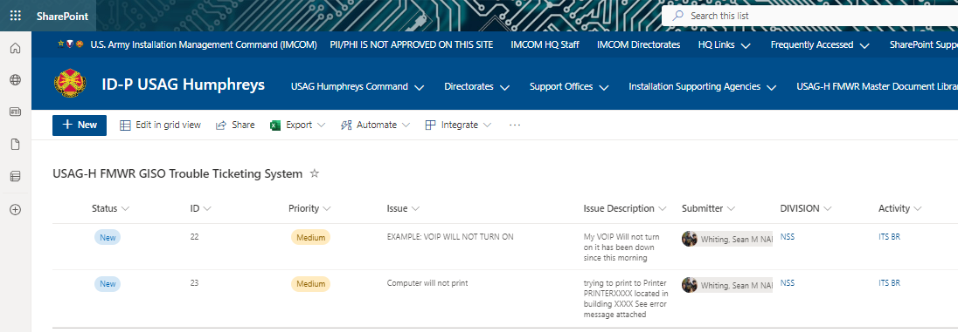
Submitting MWR IT HELPDESK
How-To Guide
CUI
Once the Form has been submitted you will be brought back to this screen
The Ticket # is located under the “ID” Column
An email will be automatically Generated and set to the Submitter
9
CUI

Slide 10
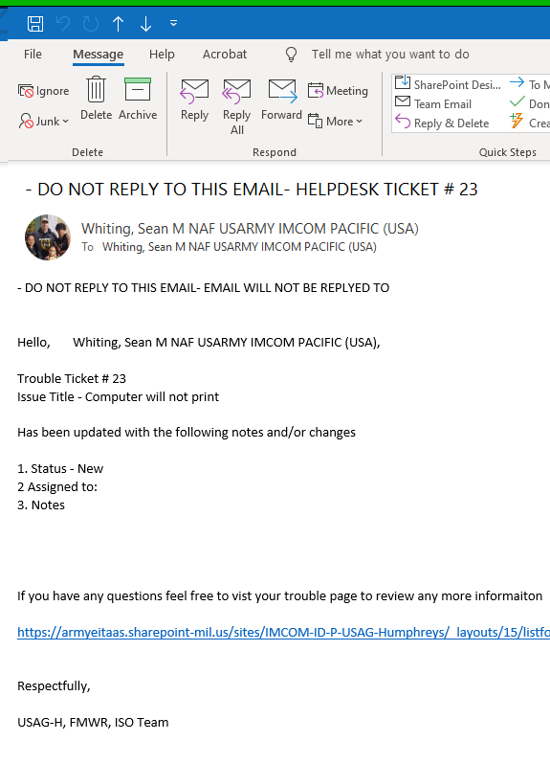
Submitting MWR IT HELPDESK
How-To Guide
CUI
The email you receive will look like this.
This will be automatically generated for a new record and with any updates to an existing record.
This updated email will have the Ticket Number, Status, Who on the team it was assigned to
And any Notes that were enter about the ticket
The list at the bottom of the email will take you back to the Ticket for your review or updates or new information that you may wish to add
10
CUI

Slide 11
CUI
Tracking an IT HELPDESK
How-To Guide
11
CUI

Slide 12
Tracking MWR IT HELPDESK
How-To Guide
CUI
Navigate to: USAG-H, FMWR, NAF Support Management (NSM), GISO (sharepoint-mil.us)
Click on “View Status of your Ticket”
**It might ask you to sign in with your CAC credentials**
12
CUI

Slide 13
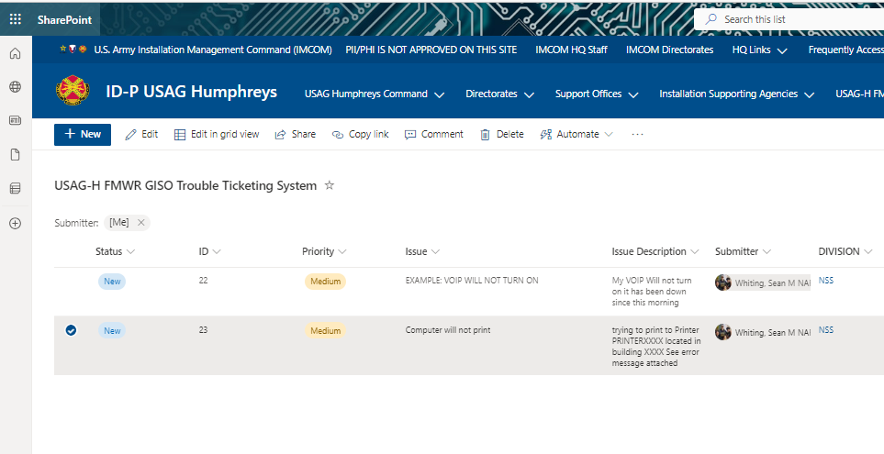
Tracking MWR IT HELPDESK
How-To Guide
CUI
From here you may update the notes section of the ticket if needed by selecting the line
Then Selecting “Edit”
13
CUI

Slide 14
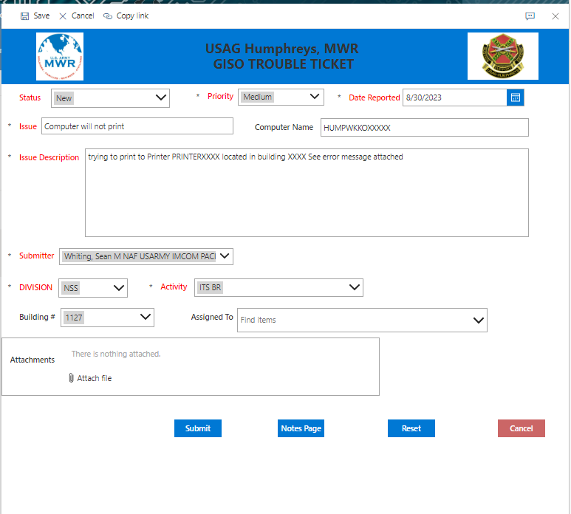
Tracking MWR IT HELPDESK
How-To Guide
CUI
You may update information on this page
If information was updated please select “Submit”
Or if you would like to review the “Notes” please Select the “Notes Page”
***DO NOT USE THE SAVE, CANCEL, or Copy Link buttons on the top of the form
14
CUI

Slide 15
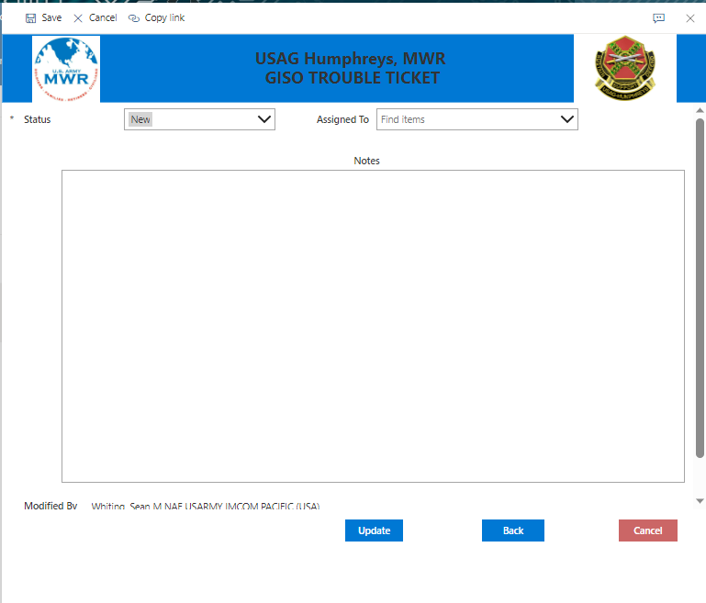
Tracking MWR IT HELPDESK
How-To Guide
CUI
You may update information on this page or review any notes that are part of this ticket entered by the technician
If you update any information, please click “Update” when finished
Note: You must select ‘Update” if any information was updated on this page for it to be added to the ticket
***DO NOT USE THE SAVE, CANCEL, or Copy Link buttons on the top of the form
15
CUI

